Slide 1
Ggplot2 and interactive graphics with R
Christophe Ladroue
SECTION 05
Customizing your plots
www.PacktPub.com

Slide 2
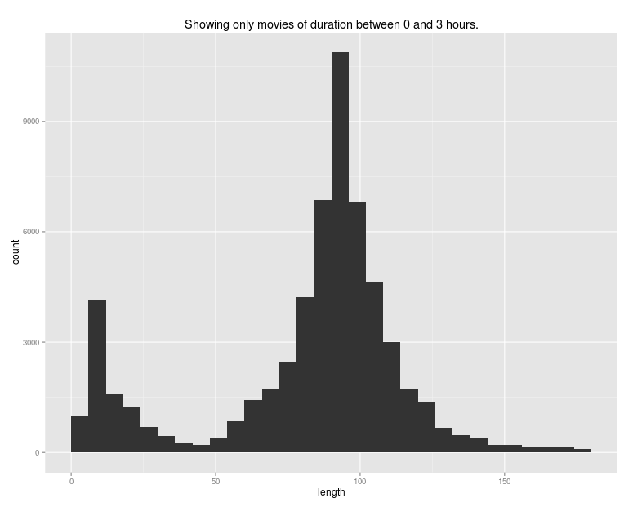
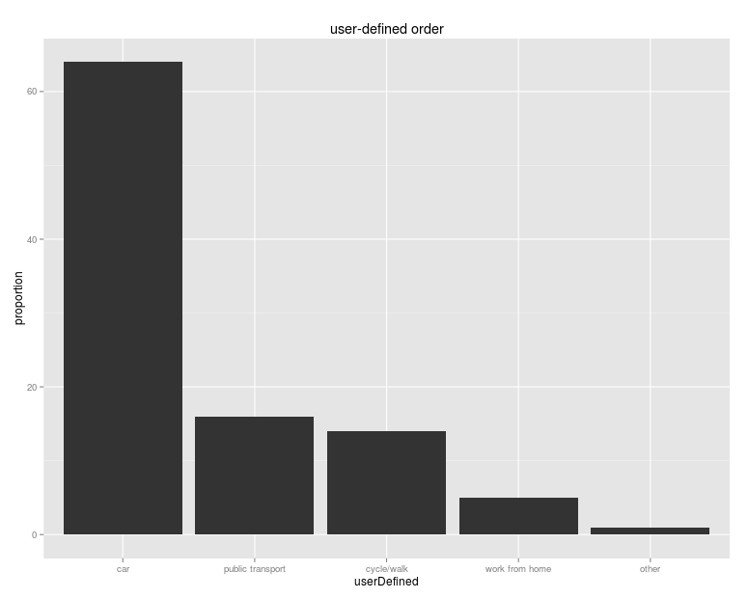
In this video we took a look at
using different scales for the plot, without modifying the data.
setting limits on the axes to investigate portions of the plot, without having to subset the data beforehand.
Next: controlling the order of factors

